Slide 1
Chapter 3: Implementing VLAN Security
Routing And Switching
Notes:
Cisco Networking Academy program
Routing & Switching
Chapter 3: Implementing VLAN Security

Slide 2
Overview Of VLANs VLAN Definitions
VLAN (virtual LAN) is a logical partition of a layer 2 network
Multiple partition can be created, allowing for multiple VLANs to co-exist
Each VLAN is a broadcast domain, usually with its own IP network address range
VLANS are mutually isolated and packets can only pass between them through a Layer 3 device (router)
The partitioning of the layer 2 network takes inside a layer 2 device, usually a switch.
The hosts grouped within a VLAN are unaware of the VLAN’s existence
Notes:
3.1 VLAN Segmentation
3.1.1 Overview of VLANs
3.1.1.1 VLAN Definitions

Slide 3
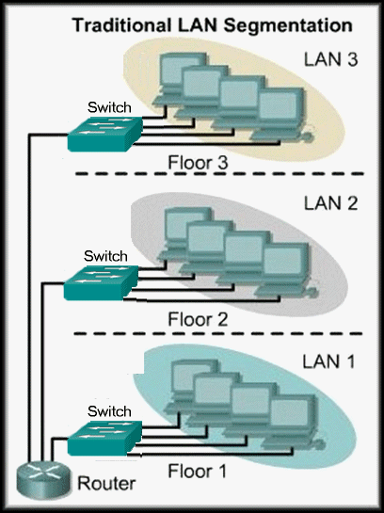
Layer 3 Segmentation
Separate Broadcast Domains
In traditional switched LANs, the physical topology is closely related to the logical topology.
Generally, workstations must be grouped by their physical proximity to a switch.
To communicate among LANs, each segment must have a connected to a layer 3 device i.e. a router.

Slide 4
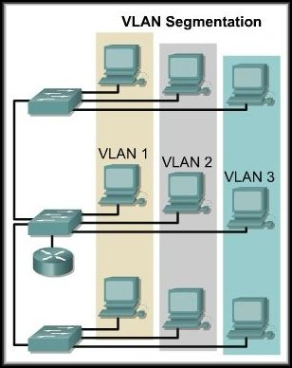
Defining VLANs
Separate Broadcast Domains
VLANs provide segmentation based on broadcast domains.
VLANs logically segment switched networks based on the functions, project teams, or applications of the organization regardless of the physical location or connections to the network.
Communication among VLANs still require a router. BUT, only one physical connection will handle all routing.
A VLAN is a logically (but not physically) separate IP subnetwork.

Slide 5
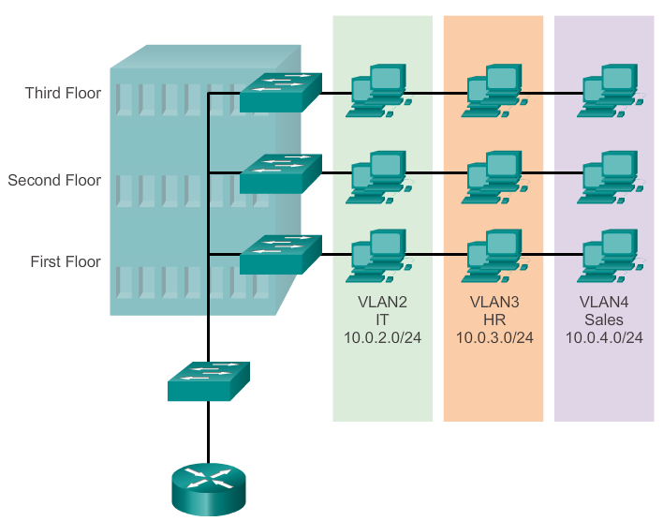
Overview Of VLANs VLAN Definitions
Notes:
3.1 VLAN Segmentation
3.1.1 Overview of VLANs
3.1.1.1 VLAN Definitions

Slide 6
VLAN Overview
For computers to communicate on the same VLAN,
Each must have an IP address and a subnet mask that is consistent for that VLAN. (All PC’s on same subnet)
The switch has to be configured with the VLAN
Each port in the switch must be assigned to the VLAN.
Remember, just because two computers are physically connected to the same switch does not mean that they can communicate.
Switches may not forward any traffic between VLANs, as this would violate the integrity of the VLAN broadcast domain.
Devices on two separate networks and subnets (or VLANs) must communicate via a router (Layer 3). Traffic must be routed between VLANs.
Notes:
Use graphic 1.1.1.1
Use graphic 1.1.1.3

Slide 7
Overview Of VLANs Benefits of VLANs
Security - Groups that have sensitive data are separated from the rest of the network, decreasing the chances of confidential information breaches. Example staff traffic can be completely separated from student and guest data traffic.
Cost reduction - Cost savings result from reduced need for expensive network upgrades and more efficient use of existing bandwidth and uplinks.
Better performance - Dividing flat Layer 2 networks into multiple logical workgroups (broadcast domains) reduces unnecessary traffic on the network and boosts performance.
Shrink broadcast domains - Dividing a network into VLANs reduces the number of devices in the broadcast domain thus broadcasts do not travel so far.
Improved IT staff efficiency - VLANs make it easier to manage the network because users with similar network requirements share the same VLAN. When a new switch is provisioned, all the policies and procedures already configured for the particular VLAN are implemented when the ports are assigned. It is also easy for the IT staff to identify the function of a VLAN by giving it an appropriate name.
Simpler project and application management - VLANs aggregate users and network devices to support business or geographic requirements. Having separate functions makes managing a project or working with a specialized application easier; an example of such an application is an e-learning development platform for faculty.
Notes:
3.1 VLAN Segmentation
3.1.1 Overview of VLANs
3.1.1.2 Benefits of VLANs

Slide 8
Overview Of VLANs Types of VLANs
There are a number of distinct types of VLANs used in modern networks. Some VLAN types are defined by traffic classes. Other types of VLANs are defined by the specific function that they serve. Example:
Data VLAN
Default VLAN
Management VLAN
Native VLAN
A native VLAN is assigned to an 802.1Q trunk port. Trunk ports are the links between switches that support the transmission of traffic associated with more than one VLAN. An 802.1Q trunk port supports traffic coming from many VLANs (tagged traffic), as well as traffic that does not come from a VLAN (untagged traffic). The 802.1Q trunk port places untagged traffic on the native VLAN, which by default is VLAN 1.
Notes:
3.1 VLAN Segmentation
3.1.1 Overview of VLANs
3.1.1.3 Types of VLANs

Slide 9
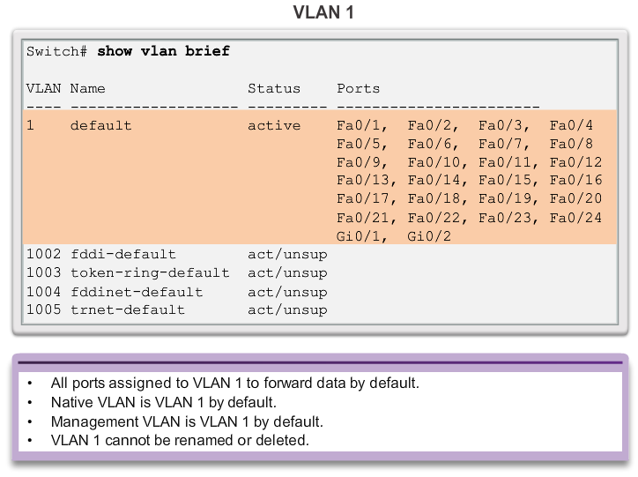
Overview Of VLANs Types of VLANs
Notes:
3.1 VLAN Segmentation
3.1.1 Overview of VLANs
3.1.1.3 Types of VLANs

Slide 10
Overview Of VLANs Voice VLANs
A separate VLAN is needed to support Voice over IP (VoIP). VoIP traffic requires:
Assured bandwidth to ensure voice quality
Transmission priority over other types of network traffic
Ability to be routed around congested areas on the network
Delay of less than 150 ms across the network
The voice VLAN feature enables access ports to carry IP voice traffic from an IP phone
The switch can connect to a Cisco 7960 IP Phone and carry IP voice traffic
Because the sound quality of an IP phone call can deteriorate if the data is unevenly sent, the switch supports quality of service (QoS)
(The details of how to configure a network to support VoIP are beyond the scope of the course)
Notes:
3.1 VLAN Segmentation
3.1.1 Overview of VLANs
3.1.1.4 Voice VLANs

Slide 11
VLANs in a Multi-Switched Environment VLAN Trunks
A VLAN trunk carries more than one VLAN
Usually established between switches so same-VLAN devices can communicate even if physically connected to different switches
A VLAN trunk is not associated to any VLANs. Neither is the trunk ports used to establish the trunk link
Cisco IOS supports IEEE 802.1q, a popular VLAN trunk protocol
Notes:
3.1 VLAN Segmentation
3.1.2 VLANs in a Multi-Switched Environment
3.1.2.1 VLAN Trunks

Slide 12
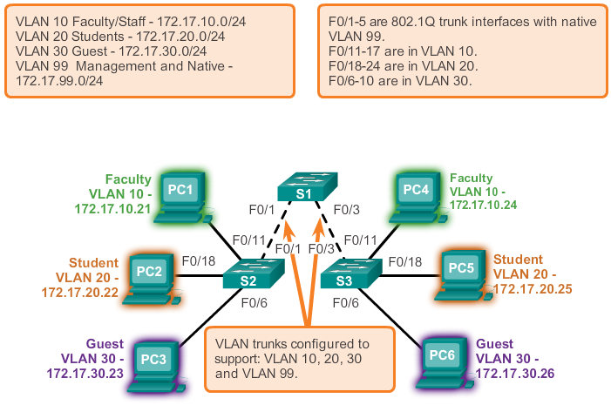
VLANs in a Multi-Switched Environment VLAN Trunks
Notes:
3.1 VLAN Segmentation
3.1.2 VLANs in a Multi-Switched Environment
3.1.2.1 VLAN Trunks

Slide 13
VLANs in a Multi-Switched Environment Controlling Broadcast Domains with VLANs
VLANs can be used to limit the reach of broadcast frames
A VLAN is a broadcast domain of its own
Therefore, a broadcast frame sent by a device in a specific VLAN is forwarded within that VLAN only.
This help controlling the reach of broadcast frames and their impact in the network
Unicast and multicast frames are forwarded within the originating VLAN as well
Notes:
3.1 VLAN Segmentation
3.1.2 VLANs in a Multi-Switched Environment
3.1.2.2 Controlling Broadcast Domains with VLANs

Slide 14
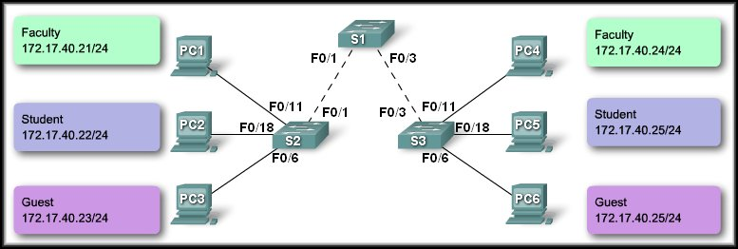
Controlling Broadcast Domain with VLANs
Network Without VLANS
In normal operation, when a switch receives a broadcast frame on one of its ports, it forwards the frame out all other ports on the switch.
In the figure, the entire network is configured in the same subnet, 172.17.40.0/24. As a result, when the faculty computer, PC1, sends out a broadcast frame, the entire network receives it.
Sends a Broadcast
Notes:
Use graphic 1.1.1.1
Use graphic 1.1.1.3

Slide 15
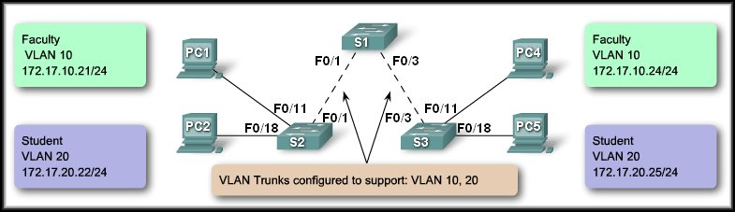
Controlling Broadcast Domain with VLANs
Network with VLANs
In the figure, the network has been segmented into two VLANs: Faculty as VLAN 10 and Student as VLAN 20.
When the broadcast frame is sent from the faculty computer, PC1, to switch S2, the switch forwards that broadcast frame only to those switch ports configured to support VLAN 10.
In the figure, the ports that make up the connection between switches S2 and S1 (ports F0/1) and between S1 and S3 (ports F0/3) have been configured to support all the VLANs in the network. This connection is called a trunk. You will learn more about trunks later in this chapter.
Sends a Broadcast
Sends a Broadcast

Slide 16
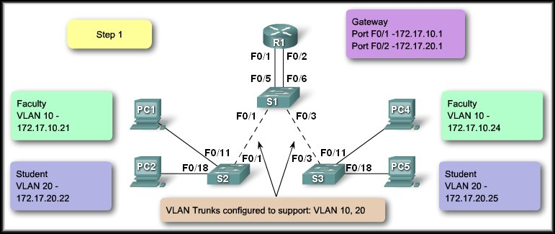


Intra-VLAN

Slide 17
Inter-VLAN Communications

Slide 18



Intra-VLAN Communications:

Slide 19
VLANs in a Multi-Switched Environment Tagging Ethernet Frames for VLAN Identification
Frame tagging is used to properly transmit multiple VLAN frames through a trunk link
Switches will tag frames to identify the VLAN they belong. Different tagging protocols exist, with IEEE 802.1q being a very popular one
The protocol defines the structure of the tagging header added to the frame
Switches will add VLAN tags to the frames before placing them into trunk links and remove the tags before forwarding frames through non-trunk ports
Once properly tagged, the frames can transverse any number of switches via trunk links and still be forward within the correct VLAN at the destination
Notes:
3.1 VLAN Segmentation
3.1.2 VLANs in a Multi-Switched Environment
3.1.2.3 Tagging Ethernet Frames for VLAN Identification

Slide 20
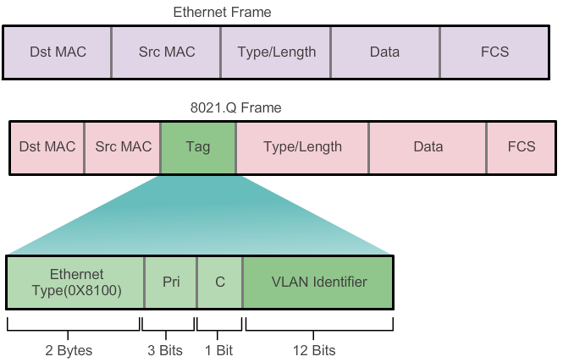
VLANs in a Multi-Switched Environment Tagging Ethernet Frames for VLAN Identification
Notes:
3.1 VLAN Segmentation
3.1.2 VLANs in a Multi-Switched Environment
3.1.2.3 Tagging Ethernet Frames for VLAN Identification

Slide 21
VLANs in a Multi-Switched Environment Native VLANs and 802.1q Tagging
A frame that belongs to the native VLAN will not be tagged
A frame that is received untagged will remain untagged and placed in the native VLAN when forwarded
If there are not ports associated to the native VLAN and no other trunk links, an untagged frame will be dropped
In Cisco switches, the native VLAN is VLAN 1 by default
Notes:
3.1 VLAN Segmentation
3.1.2 VLANs in a Multi-Switched Environment
3.1.2.4 Native VLANs and 802.1q Tagging

Slide 22
802.1Q Frame Tagging
Switches are layer 2 devices. They only use the Ethernet frame header information to forward packets.
The frame header does not contain information about which VLAN the frame should belong to. When Ethernet frames are placed on a trunk they need additional information about the VLANs they belong to.
This header adds a tag to the original Ethernet frame specifying the VLAN for which the frame belongs to.
Normal Ethernet Frame (Length 1518 Bytes)
6 | 6 | 2 | 1500 | 4
Destination Address | Source Address | Type / Length | Data Max of 1500 Bytes | FCS
Tagged Ethernet Frame (Length 1522 Bytes)
6 | 6 | 2 | 2 | 2 | 1500 | 4
Destination Address | Source Address | 802.1Q Tag |  | Type/ Length | Data Max of 1500 Bytes | New FCS
3 Bits | 1 Bit | 12 Bits
User Priority | CFI | VLAN ID
Canonical Format Identifier
Notes:
Use graphic 1.1.1.1
Use graphic 1.1.1.3

Slide 23
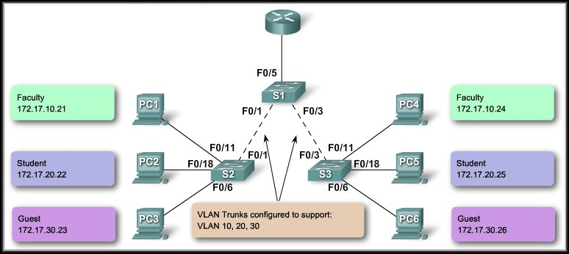
Trunking Operation
The tagged frames are sent across the trunk links between S2 and S1 and S1 and S3.
PC1 and PC3 send a broadcast.
10
10
20
20
30
30
S3 strips the tags and forwards to the destination.
S2 receives the frames and ‘tags’ them with the VLAN ID.

Slide 24
VLAN Assignment VLAN Ranges On Catalyst Switches
The Catalyst 2960 and 3560 Series switches support over 4,000 VLANs
These VLANs are split into 2 categories:
Normal Range VLANs
VLAN numbers from 1 through 1005
Configurations stored in the vlan.dat (in the flash)
VTP can only learn and store normal range VLANs
Extended Range VLANs
VLAN numbers from 1006 through 4096
Configurations stored in the running-config (in the NVRAM)
VTP does not learn extended range VLANs
Notes:
3.2 VLAN Implementations
3.2.1 VLAN Assignment
3.2.1.1 VLAN Ranges On Catalyst Switches

Slide 25
Configuring VLANs and Trunks
Create the VLANs.
Assign switch ports to VLANs statically.
Verify VLAN configuration.
Enable trunking on the inter-switch connections.
Verify trunk configuration.
Notes:
Use graphic 1.1.1.1
Use graphic 1.1.1.3

Slide 26
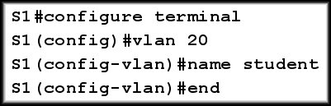
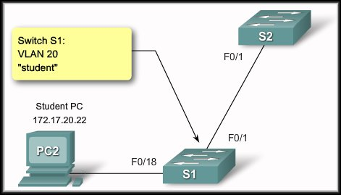
Step 1: Configure a VLAN
You will configure VLANs with IDs in the normal range.
The normal range includes IDs 1 to 1001.
The extended range consists of IDs 1006 to 4094.
VLAN 1 and 1002 to 1005 are reserved ID numbers.
When you configure normal range VLANs, the configuration details are stored automatically in flash memory on the switch in a file called vlan.dat.
The figure shows how the student VLAN, VLAN 20, is configured on switch S1.
In addition to entering a single VLAN ID, you can enter a series of VLAN IDs separated by commas, or a range of VLAN IDs separated by hyphens using the vlan vlan-id command, for example:
switch(config)# vlan 100,102,105-107.
Notes:
Use graphic 1.1.1.1
Use graphic 1.1.1.3

Slide 27
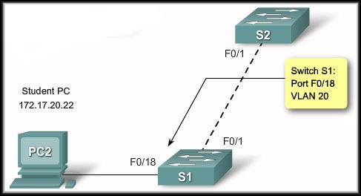
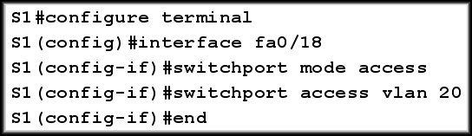
Step 2: Assign a Switch Port
After you have created a VLAN, assign one or more ports to the VLAN. When you manually assign a switch port to a VLAN, it is known as a static access port.
A static access port can belong to only one VLAN at a time.
Example shows how the student VLAN, VLAN 20, is statically assigned to port F0/18 on switch S1.
Port F0/18 has been assigned to VLAN 20 so the student computer, PC2, is in VLAN 20.
When VLAN 20 is configured on other switches, the network administrator knows to configure the other student computers to be in the same subnet as PC2: 172.17.20.0 /24.
Notes:
Use graphic 1.1.1.1
Use graphic 1.1.1.3

Slide 28
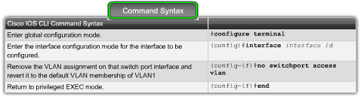
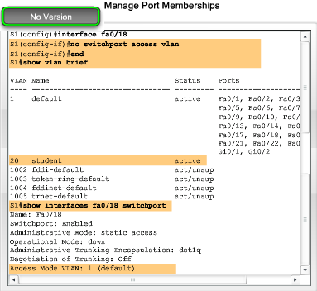
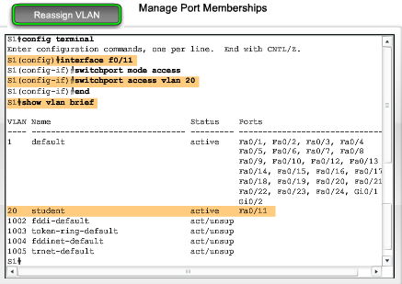
Step 3: Manage Port Memberships
Reassign a Port to VLAN 1
To reassign a port to VLAN 1, you can use the no switchport access vlan command in interface configuration mode.
Examine the output in the show vlan brief command that immediately follows.
Notice how VLAN 20 is still active. It has only been removed from interface F0/18.
In the show interfaces f0/18 switchport command, you can see that the access VLAN for interface F0/18 has been reset to VLAN 1 (It was on vlan 20).
Reassign the VLAN to Another Port
A static access port can only have one VLAN.
When you reassign a static access port to an existing VLAN, the VLAN is automatically removed from the previous port.
In the example, port F0/11is reassigned to VLAN 20 .
Notes:
Use graphic 1.1.1.1
Use graphic 1.1.1.3

Slide 29
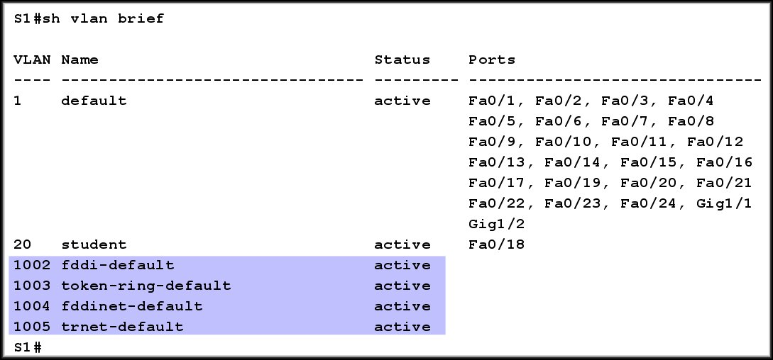
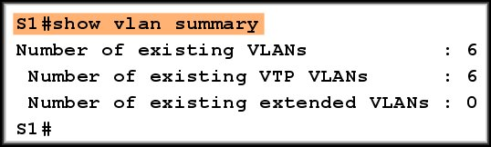
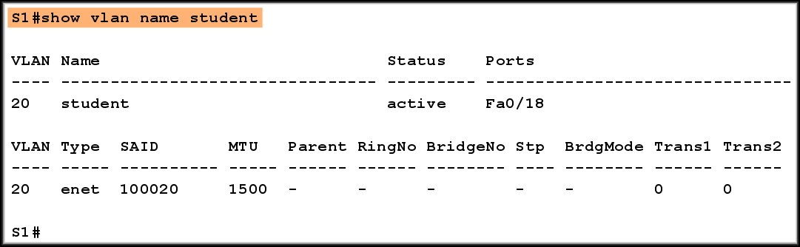
Verify VLAN configuration
show vlan brief
show vlan summary
show vlan name student

Slide 30


Step 3: Delete VLANs
Remove port VLAN membership.
Remove a VLAN
If you remove the VLAN before removing the port membership assignments, the ports become unusable until you issue the no switchport access vlan command.
Alternatively, the entire vlan.dat file can be deleted using the command
delete flash:vlan.dat from privileged EXEC mode.
After the switch is reloaded, the previously configured VLANs will no longer be present.
This effectively places the switch into is "factory default" concerning VLAN configurations.

Slide 31
Step 4: Configure an 802.1Q Trunk
To configure a trunk on a switch port, use the switchport mode trunk command.
When you enter trunk mode, the interface changes to permanent trunking mode, and the port enters into a DTP negotiation to convert the link into a trunk link even if the interface connecting to it does not agree to the change.
The Cisco IOS command syntax (switchport trunk native) to specify a native VLAN other than VLAN 1 is shown in the figure.
In the example, you configure VLAN 99 as the native VLAN.
Remember the Native VLAN is for untagged traffic.
Notes:
Use graphic 1.1.1.1
Use graphic 1.1.1.3

Slide 32
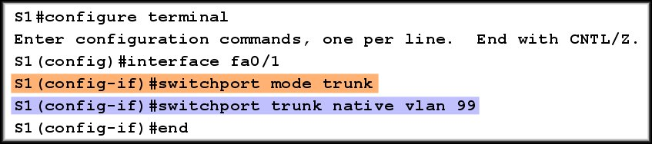
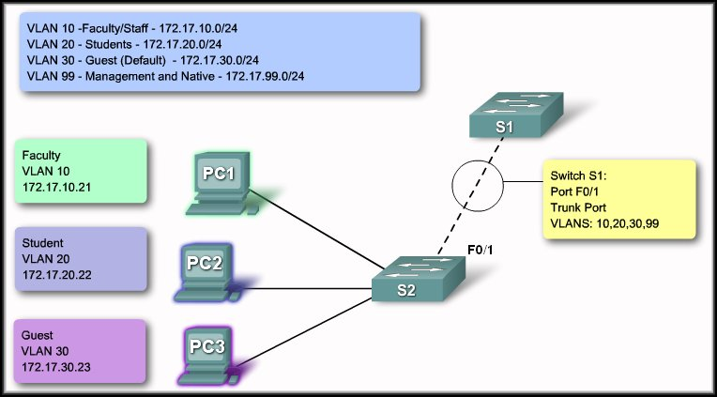
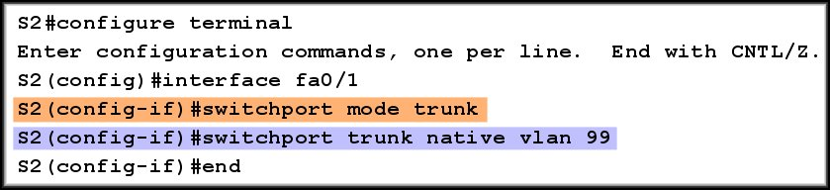
Configure a Trunk
The native VLAN must match on both switches.

Slide 33
Dynamic Trunking Protocol Introduction to DTP
Switch ports can be manually configured to form trunks
Switch ports can also be configured to negotiate and establish a trunk link with a connected peer automatically
Dynamic Trunking Protocol (DTP) is a protocol to manage trunk negotiation
DTP is a Cisco proprietary protocol and is enabled by default in Cisco Catalyst 2960 and 3560 switches
If the port on the neighbor switch is configured in a trunk mode that supports DTP, it manages the negotiation
The default DTP configuration for Cisco Catalyst 2960 and 3560 switches is dynamic auto
Notes:
3.2 VLAN Implementations
3.2.3 Dynamic Trunking Protocol
3.2.3.1 Introduction to DTP

Slide 34
Trunking Mode: DTP
Mode | What the Mode Does
On (Trunk) | Forces the link into permanent trunking, even if the neighbor doesn't agree
off | Forces the link to permanently not trunk, even if the neighbor doesn't agree
desirable | Causes the port to actively attempt to become a trunk, subject to neighbor agreement (neighbor set to on, desirable, or auto. If the neighboring interface is set to the access or non-negotiate mode, the link will become a non-trunking link.
auto | Causes the port to passively be willing to convert to trunking. The port will not trunk unless the neighbor is set to on or desirable . This is the default mode. Note that auto-auto (both ends default) links will not become trunks.
nonegotiate | Forces the port to permanently trunk but not send DTP frames. For use when the DTP frames confuse the neighboring (non-Cisco) 802.1q switch. You must manually configure the neighboring interface as a trunk interface to establish a trunk link, otherwise the link will be a non-trunking link.

Slide 35
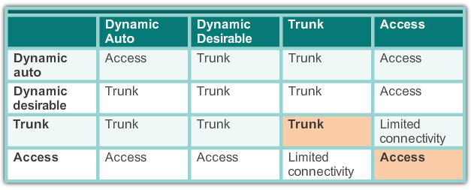
Dynamic Trunking Protocol DTP Modes
Switch 1
Switch 2

Slide 36
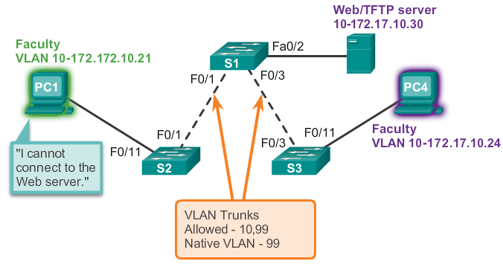
Troubleshooting VLANs and Trunks Addressing Issues with VLAN
It is very common practice to associate a VLAN with a IP network
Since different IP networks only communicate through a router, all devices within a VLAN must be part of the same IP network in order to communicate
In the picture below, PC1 can’t communicate to the server because it has a wrong IP address configured
Notes:
3.2 VLAN Implementations
3.2.4 Troubleshooting VLANs and Trunks
3.2.4.1 Addressing Issues with VLAN

Slide 37
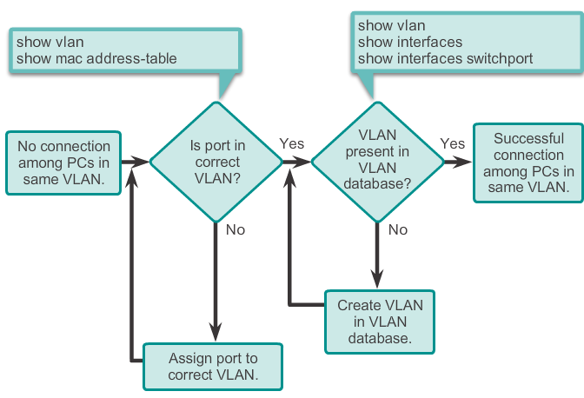
Troubleshooting VLANs and Trunks Missing VLANs
If all IP addresses mismatch have been solved but device still can’t connect, check if the VLAN exists in the switch.
Notes:
3.2 VLAN Implementations
3.2.4 Troubleshooting VLANs and Trunks
3.2.4.2 Missing VLANs

Slide 38
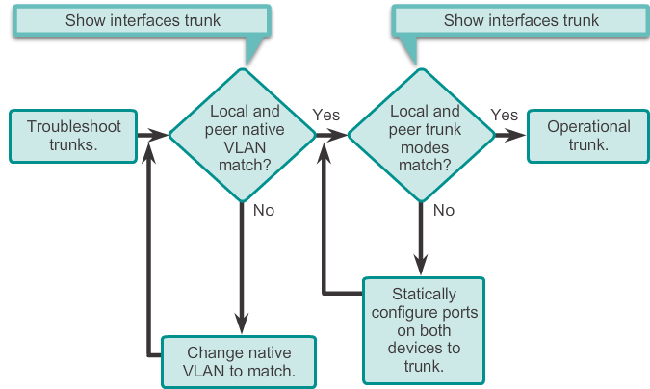
Troubleshooting VLANs and Trunks Introduction to Troubleshooting Trunks
Notes:
3.2 VLAN Implementations
3.2.4 Troubleshooting VLANs and Trunks
3.2.4.3 Introduction to Troubleshooting Trunks

Slide 39
Troubleshooting VLANs and Trunks Common Problems With Trunks
Trunking issues are usually associated with incorrect configurations.
The most common type of trunk configuration errors are:
Native VLAN mismatches
Trunk mode mismatches
Allowed VLANs on trunks
If a trunk problem is detected, the best practice guidelines recommend to troubleshoot in the order shown above.
Notes:
3.2 VLAN Implementations
3.2.4 Troubleshooting VLANs and Trunks
3.2.4.4 Common Problems With Trunks

Slide 40
Troubleshooting VLANs and Trunks Trunk Mode Mismatches
If a port on a trunk link is configured with a trunk mode that is incompatible with the neighboring trunk port, a trunk link fails to form between the two switches
Check the status of the trunk ports on the switches using the show interfaces trunk command
To fix the problem, configure the interfaces with proper trunk modes.
Notes:
3.2 VLAN Implementations
3.2.4 Troubleshooting VLANs and Trunks
3.2.4.5 Trunk Mode Mismatches

Slide 41
Troubleshooting VLANs and Trunks Incorrect VLAN List
VLANs must be allowed in the trunk before their frames can be transmitted across the link
Use the switchport trunk allowed vlan command to explicitly specify which VLANs are allowed in a trunk link
To ensure the correct VLANs are permitted in a trunk, used the show interfaces trunk command
Notes:
3.2 VLAN Implementations
3.2.4 Troubleshooting VLANs and Trunks
3.2.4.6 Incorrect VLAN List

Slide 42
Attacks on VLANs Switch spoofing Attack
There are a number of different types of VLAN attacks in modern switched networks. VLAN hopping is one them.
The default configuration of the switch port is dynamic auto
By configuring a host to act as a switch and form a trunk, an attacker could gain access to any VLAN in the network.
Because the attacker is now able to access other VLANs, this is called a VLAN hopping attack
To prevent a basic switch spoofing attack, turn off trunking on all ports, except the ones that specifically require trunking
Notes:
3.3 VLAN Implementations
3.3.1 Attacks on VLANs
3.3.1.1 Switch spoofing Attack

Slide 43
Attacks on VLANs Double-Tagging Attack
The double-tagging attack takes advantage of the way that hardware on most switches de-encapsulate 802.1Q tags
Most switches perform only one level of 802.1Q de-encapsulation, allowing an attacker to embed a second, unauthorized attack header in the frame
After removing the first and legit 802.1Q header, the switch forwards the frame to the VLAN specified in the unauthorized 802.1Q header
The best approach to mitigating double-tagging attacks is to ensure that the native VLAN of the trunk ports is different from the VLAN of any user ports
Notes:
3.3 VLAN Implementations
3.3.1 Attacks on VLANs
3.3.1.2 Double-Tagging Attack

Slide 44
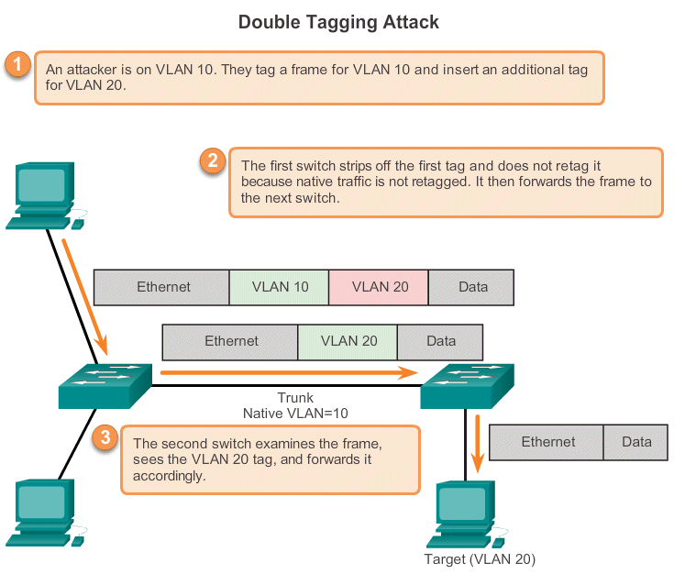
Attacks on VLANs Double-Tagging Attack
The attacker who is on VLAN 10 and cannot access his target on VLAN20, sends a double-tagged 802.1Q frame to the switch. The outer header has the VLAN tag of the attacker, which is the same as the native VLAN of the trunk port.
Notes:
3.3 VLAN Implementations
3.3.1 Attacks on VLANs
3.3.1.2 Double-Tagging Attack

Slide 45
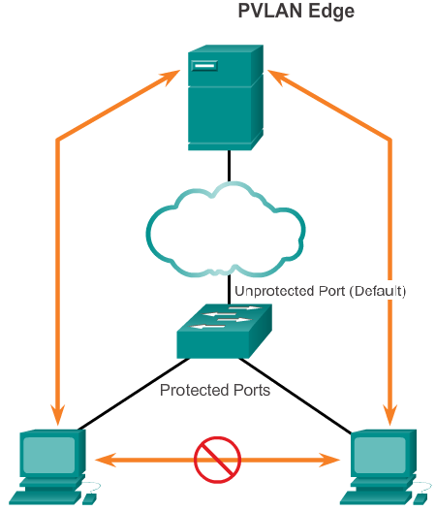
Attacks on VLANs PVLAN Edge
Private VLAN (PVLAN) Edge feature, also known as protected ports, ensures that there is no exchange of unicast, broadcast, or multicast traffic between protected ports on the switch
Local relevancy only
A protected port only exchanges traffic with un-protected ports
A protected port will not exchange traffic with another protected port
Notes:
3.3 VLAN Implementations
3.3.1 Attacks on VLANs
3.3.1.3 PVLAN Edge

Slide 46
Design Best Practices For VLANs VLAN Design Guideline
Move all ports from VLAN1 and assign them to a not-in-use VLAN
Shut down all unused switch ports
Separate management and user data traffic
Change the management VLAN to a VLAN other than VLAN1. The same goes to the native VLAN
Make sure that only devices in the management VLAN can connect to the switches
The switch should only accept SSH connections
Disable autonegotiation on trunk ports
Do not use the auto or desirable switch port modes
Notes:
3.3 VLAN Implementations
3.3.2 Design Best Practices For VLANs
3.3.2.1 VLAN Design Guideline

Slide 47


